Slide 1

Opportunities for Undergraduates in Electrical & Computer Engineering
Fellowships, Undergraduate Research, and the BYU Honors Program
Prof. Karl F. Warnick
Department Honors Advisor
honors.ece.byu.edu

Slide 2
Honors@ece is a program in the Department of Electrical & Computer Engineering that provides
Undergraduate research opportunities
Undergraduate Research Rotations
Mentored research experiences
Support for students in the BYU Honors Program
You do not have to be an honors student to participate
For more information:
  http://honors.ece.byu.edu/
  Contact Prof. Warnick

Slide 3


Slide 4
BYU Honors Program
The ideal engineering student has strong technical skills, is creative, excels at communication and critical thinking, and has a broad education
BYU Honors program is a perfect way to enrich the university experience and realize full potential in a technical career and in the community
University Honors is the highest recognition awarded to graduates and recorded on diploma and official transcript

Slide 5
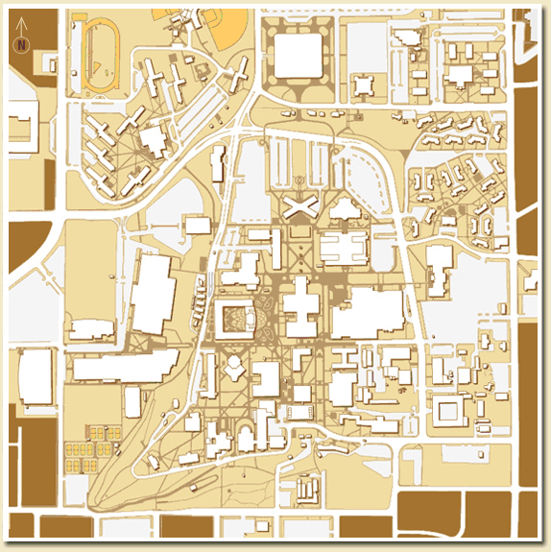

The Basics…
Enroll in the program (Maeser Building)

Slide 6
The Basics…
Take Classes
Experiential Learning
Great Questions
Honors Thesis (Senior Year)
Honors classes
  Satisfy GE requirements!
  Have smaller sizes
  High quality teaching
  More discussion
  Less busy work, not necessarily more difficult!

Slide 7
Undergraduate Research

Slide 8
What is undergraduate research?
Most commonly:
  A student is hired in the Junior or Senior year by an faculty member as a research assistant (paid)
  Works with graduate students and other team members on an open research question, experiment, mathematical analysis, numerical simulation, or hardware design
  5-10 hours per week (sometimes up to 20) at university-designated rate (approx. $11/hr) in Fall and Winter, more hours during Spring/Summer terms
  May go on to obtain an MS or PhD degree at BYU or elsewhere, apply for prestigious national fellowships, publish a paper on original research
Less common:
  Independent research
  Unpaid or volunteer research
  Research in other departments

Slide 9
Benefits of Undergraduate Research
Apply classroom knowledge
Be a part of world-class research projects
Enriches the university experience
Form close connections with faculty and graduate students
Obtain academic year and summer stipends
Prepare for senior projects and Honors Thesis
Assistance with graduate school admissions and fellowships
Work in a stimulating collaborative team environment
Faculty
Graduate Students
Undergraduates

Slide 10
Fellowships

Slide 11

BYU has a “National Scholarships, Fellowships, and Programs” Office
They are NOT BYU’s Scholarship Office or BYU’s Financial Aid Office
What they do:
  Promote national & international scholarships & fellowships
  Help students apply for external scholarships
  Make scholarship resources easily accessible
Where they are:
  102B MRSB
  M-F 9:00AM-5:00PM
Contact info:
  prestigious_scholarships@byu.edu
  (801) 422-6137
  http://nsfp.byu.edu/

Slide 12
National Undergraduate Scholarships
Barry M. Goldwater
Morris K. Udall
National Security Education Program
Phi Eta Sigma
Phi Kappa Phi
Golden Key
Harry S. Truman

Slide 13
Graduate Fellowships
General and Humanities Fellowships:
Marshall
Mitchell
Rhodes
Gates
Fulbright
Institute for Humane Studies (IHS)
Intercollegiate Studies Institute (ISI)
National Security Education Program (Boren)
Woodrow Wilson (Pickering)
Samuel Huntington Public Service Award
James Madison Memorial Fellowship
Science, Engineering & Technology:
Hertz Foundation
Department of Energy Computational Science Graduate Fellowship
National Defense Science and Engineering Graduate Research Fellowship
National Science Foundation Graduate Research Fellowship Program
NASA Space Technology Research Fellowship
National Institutes of Health-Graduate Partnerships Program
Rocky Mountain NASA Space Grant
Tau Beta Pi (Engineering)
U.S. Department of Energy
U.S. Department of Homeland Security
Science, Mathematics And Research for Transformation (SMART) Scholarship (DOD)
Fellowships can provide $100k or more for MS and PhD studies!

Slide 14
Students Preparing for Prestigious Scholarships Should
Participate in undergraduate research
Develop meaningful relationships with people who can open doors for you – faculty mentor!
Seek out leadership positions.
Involve yourself in extra-curricular activities.
Know scholarship eligibility requirements and deadlines.
Apply!
Keep trying!

Slide 15
Takeaways….
Freshman
Enroll in the BYU Honors Program
Register for Honors courses
Sophomores/Juniors
Find out about opportunities and get involved in undergraduate research,
Attend Undergraduate Research Rotations (see http://honors.ee.byu.edu for the date)
Develop a relationship with a faculty mentor
Learn about graduate research fellowships
Seniors
Apply for fellowships and graduate schools
E-mail: honors@ee.byu.edu
Web: honors.ee.byu.edu

